Slide 1


Phase - 2 Mini Project Presentation
S6 CSE-AI (2023-27 batch)
Adi Shankara Institute of Engineering and Technology

Slide 2
Project Title & Team
Project Title :- Efficient Code Refactoring using Distilled BDH
Architecture
Team Guide :- Miss Madhu Priya
GROUP NO: | 5 | MEMBER 1 | MEMBER 2 | MEMBER 3 | MEMBER 4
NAME |  | Fathima P Ajvad | Zayed Bin Hassan | Atul Biju | Sahil
ROLL NO |  | 27 | 62 | 21 | 54
CLASS |  | S6 CSE(AI) (2023-27 BATCH)

Slide 3
Project Title & Team
TITLE:
TEAM MEMBERS:
Fathima P Ajvad
Zayed Bin Hassan
Atul Biju
Sahil
GUIDE:
Miss Madhu Priya

Slide 4
Abstract
This project introduces a lightweight AI model for automated code debugging and simplification using the BDH (Baby Dragon Hatchling) architecture. To overcome the high latency and computational costs of large Transformers, we employ Knowledge Distillation to transfer structural logic from massive "Teacher" LLMs into a compact 150M parameter "Student" model. By optimizing for localized syntax and code semantics, this specialized architecture achieves high-efficiency performance with significantly reduced hardware requirements.

Slide 5
Introduction
The rapid advancement of Large Language Models (LLMs) has transformed software development, yet most state-of-the-art models rely on massive Transformer architectures. These models are computationally expensive, leading to high latency and significant hardware costs.
In many scenarios, such as localized syntax debugging and basic code simplification, using a multi-billion parameter model is a massive waste of resources. This project addresses this inefficiency by developing a lightweight, task-specific alternative. By utilizing the BDH (Baby Dragon Hatchling) architecture, we provide a solution that prioritizes speed and low computational overhead, making intelligent code repair accessible on standard hardware without the need for high-end GPU clusters.

Slide 6
Problem Statement
Technical Bottlenecks: Why Big Models Fail Small Fixes ?
Quadratic Scaling: O(n²) Attention
Transformer models suffer from quadratic scaling in their attention mechanism. Processing longer files leads to exponentially slower performance, making them inefficient for large codebases.
Prohibitive Cost:
High VRAM Requirements
Dense Compute:
100% Active, 1% Problem
The substantial VRAM demands of large models lock out edge devices and smaller development environments, limiting accessibility and increasing operational costs.
Despite localized issues, the entire model is active, leading to dense computation for sparse problems. This over-activation of parameters is a major source of inefficiency.

Slide 7
Objectives
To develop a lightweight AI model specifically for code debugging and simplification using the BDH-GPU architecture.
To implement Knowledge Distillation to transfer reasoning logic from high-capacity "Teacher" models into a compact "Student" framework.
To optimize for low-latency performance, allowing for real-time code fixes on consumer-grade hardware.
To reduce computational overhead by focusing on localized syntax and deterministic code transformations.
To provide automated refactoring that simplifies complex code implementations into more readable, Pythonic structures.
To validate the efficiency of specialized, task-specific architectures compared to general-purpose Transformers.

Slide 8
Proposed System / Approach
The proposed system is a lightweight code-processing framework designed to identify syntax errors and simplify complex code structures. By utilizing the BDH-GPU architecture, the system processes code through high-dimensional sparse latent spaces, allowing it to focus on localized structural patterns without the overhead of dense global attention.
The core approach centers on Knowledge Distillation, where a pre-trained "Teacher" LLM guides the training of a compact 150M parameter student model. This distillation process transfers complex reasoning capabilities into the lightweight student, enabling it to perform deterministic code fixes with high speed. The final application provides real-time, low-latency debugging and refactoring, making it suitable for deployment on standard consumer-grade hardware.

Slide 9
Methodology
Dataset Generation: Programmatic injection of common syntax and logical bugs into permissively licensed Python source code to create "Buggy → Fixed" training pairs.
Knowledge Distillation: Implementing a teacher-student framework where a high-capacity Teacher LLM transfers structural reasoning to the lightweight student.
Architecture Optimization: Utilizing the BDH (Baby Dragon Hatchling) decoder-only model, featuring rotary positional embeddings (RoPE) and sparse latent projections.
Fine-Tuning: Task-specific training using mixed-precision (BF16) and gradient checkpointing to ensure high accuracy within restricted compute limits.
Model Compression: Applying 8-bit quantization to further reduce the memory footprint and enhance inference speed on consumer-grade CPUs and GPUs.
Performance Evaluation: Measuring success through Pass@1 accuracy, Abstract Syntax Tree (AST) matching, and inference latency benchmarks.

Slide 10
System Architecture / Block Diagram
Input Layer: Receives messy or buggy Python code snippets from the user.
Preprocessing Module: Performs tokenization using byte-level BPE (Byte Pair Encoding) to handle complex code symbols.
BDH Core Engine:
Rotary Embeddings (RoPE): Provides relative positional awareness within the code structure.
Sparse Latent Layers: Expands input into high-dimensional space to identify local structural patterns.
Gated Interactions: Multiplicative filtering to isolate logical flaws.
Inference Controller: Manages token generation with temperature and top-k sampling for diverse refactoring options.
Post-Processing: Formats the output into clean, simplified, and executable Python code.

Slide 11
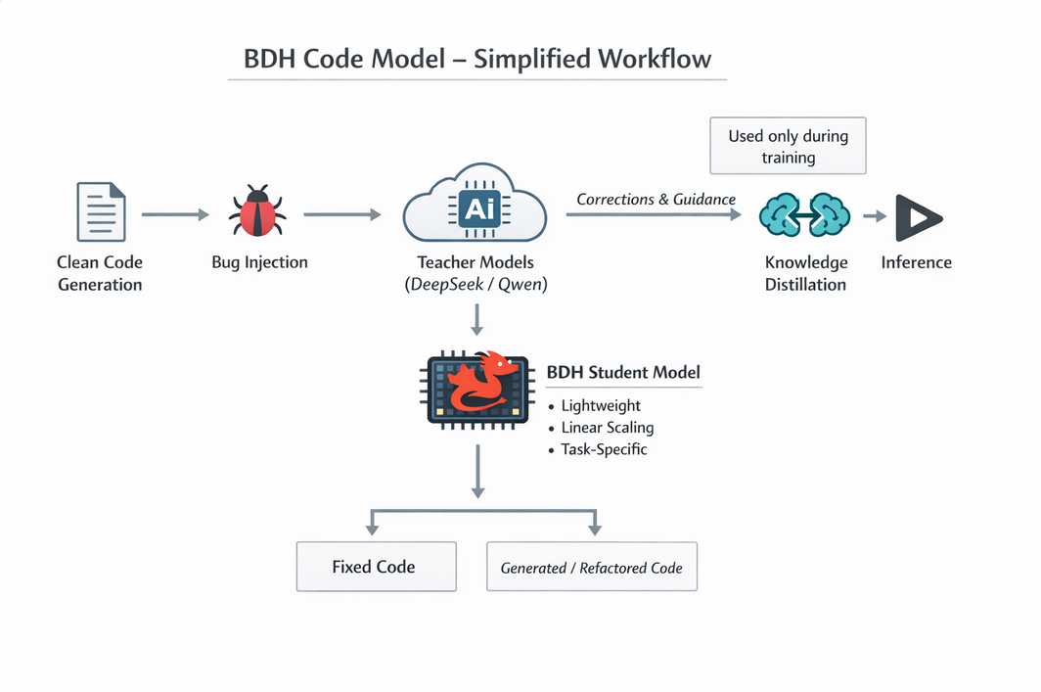
Workflow Diagram / Flowchart

Slide 12
Hardware and Software Requirement
GPU
NVIDIA GPU with CUDA support (minimum 24 GB VRAM)
Supports FP16 / BF16 computation
Compute Setup
Local GPU systems
Cloud GPU instances (Google Colab / AWS / GCP / Azure)
Deep Learning Framework
PyTorch
Libraries
Hugging Face Transformers
Datasets
Accelerate
GPU Acceleration
CUDA Toolkit
cuDNN
Development Tools
VS Code / Jupyter Notebook
Git

Slide 13
Technology Stack
Python
PyTorch + CUDA
Hugging Face Transformers
BDH‑based Student Model
Multi‑Teacher Knowledge Distillation
Local & Cloud GPU Training

Slide 14
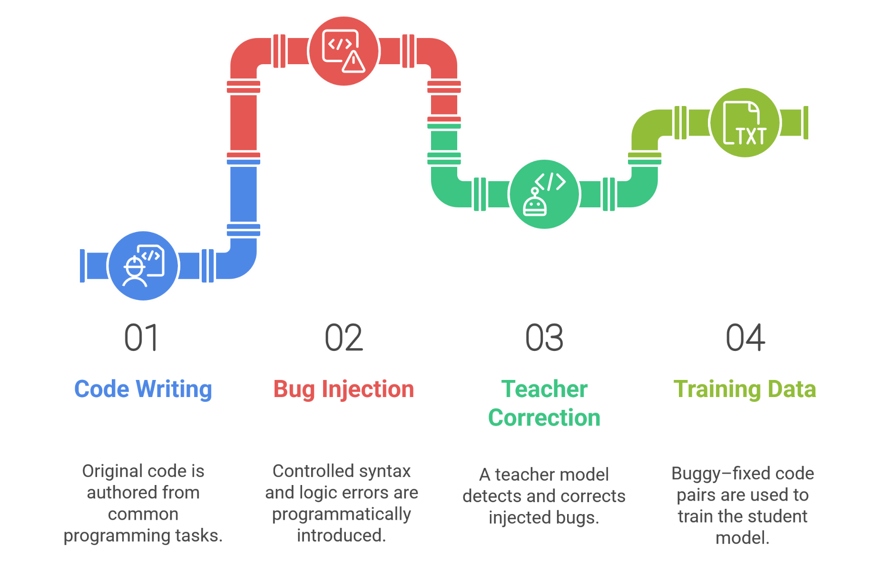
Dataset Description

Slide 15
Work Plan & Timeline
Phase | Task Description | Start Date | End Date | Deliverable
Phase 1 | Topic selection, problem statement definition, and BDH-GPU architectural scope finalization | 08-12-2025 | 06-01-2026 | Approved problem statement and project proposal
Phase 2 | Literature review of "Dragon Hatchling“ and existing code-distillation techniques. | 07-01-2026 | 07-01-2026 | Literature review report and presentation slides
Phase 3 | Software Requirements Specification (SRS) for a task-specific BDH model. | 08-01-2026 | 12-01-2026 | Submitted SRS document
Phase 4 | Environment setup using PyTorch and implementation of the BDH-GPU Kernel | 14-01-2026 | 14-01-2026 | System architecture and design document
Phase 5 | Data preprocessing for code debugging datasets and initial Phase-1 demo. | 15-01-2026 | 21-01-2026 | Front-end module and Phase-1 demo
Phase 6 | Training via knowledge distillation and integration of the linear attention block | 22-01-2026 | 11-02-2026 | Fully integrated system and final demo
Phase 7 | System testing, validation of sparsity levels, and monosemanticity Analysis | 12-02-2026 | 18-02-2026 | Approved final review and demo
Phase 8 | Draft report preparation focusing on computational cost and efficiency Metrics | 19-02-2026 | 04-03-2026 | Draft project report and paper
Phase 9 | External evaluation and final report submission. | 05-03-2026 | 18-03-2026 | Final report submission and evaluation clearance

Slide 16
Expected Outcome
Efficient Code Repair: Identification and correction of syntax and logical bugs.
High-Speed Inference: Real-time code simplification with significantly lower latency than standard Transformers.
Hardware Accessibility: Reliable performance on consumer-grade hardware without high-end GPU requirements.
Architectural Validation: Proven feasibility of using BDH-GPU architecture for deterministic, local code tasks.
Cost-Effective Deployment: drastically reduced operational costs through a compact 150M parameter student model.

Slide 17
Conclusion & Future Scope
Conclusion : The project successfully validates that a 150M parameter BDH model can execute specialized code tasks with high efficiency. By employing Knowledge Distillation, the structural logic of a large Teacher LLM was effectively condensed into a lightweight framework. This proves that task-specific, post-transformer architectures provide a low-latency, cost-effective alternative to massive models for deterministic code repair.
Future Scope :
Multi-Language Support: Expanding training to include Java, C++, and JavaScript.
IDE Integration: Developing local plugins for real-time debugging in VS Code.
Enhanced Optimization: Implementing 4-bit quantization for mobile and edge device deployment.
Complex Logic Repair: Scaling the distillation process to detect security vulnerabilities and algorithmic flaws.

Slide 18
References
A. Kosowski et al., "The Dragon Hatchling: The Missing Link Between the Transformer and Models of the Brain," Pathway Research, 2025. (Primary source for the BDH/BDH-GPU architecture)
A. Paszke et al., "PyTorch: An Imperative Style, High Performance Deep Learning Library," Advances in Neural Information Processing Systems, vol. 32, 2019. (Software framework reference).
A. Vaswani et al., "Attention is All You Need," Advances in Neural Information Processing Systems, vol. 30, 2017. (Baseline for Transformer comparison).
D. O. Hebb, The Organization of Behavior, New York: Wiley & Sons, 1949. (Foundation for the Hebbian learning rules used in BDH.
D. Haziza et al., "Accelerating Transformer Inference and Training with 2:4 Activation Sparsity," arXiv preprint arXiv:2503.16672, 2025. (Context for sparse activation benefits).
K. M. Choromanski et al., "Rethinking Attention with Performers," International Conference on Learning Representations (ICLR), 2021. (Provides the FAVOR+ framework for linear attention analysis).

